Slide 1
CARDIO-ONCOLOGY
PRESENTER-Dr.VIPINDAS.CA
CHAIR-1.DR.RAJESH.G
2.DR.RIFAI(RADIOTHERAPY)
DATE-28/02/23

Slide 2
REFERENCE
Braunwald Text book of cardiology 12 th edition.
Fuster and Hurst’s Text book of cardiology
2016 ESC position paper on cancer treatment and cardiovascular toxicity.
Journal of AHA –Radiation induced cardiovascular Disease.

Slide 3
Topics to cover
1.Field of Cardio-oncology and its scopes.
2.Anticancer drugs of cardiovascular significance
3.Cardiotoxicity of Anticancer therapy.
4.Approach to a cancer patient –cardiologists perspective

Slide 4
Cardio-oncology
Multidisciplinary field that caters the following group of patients.
1.Patients with preexisting CV disease or risk factors who develops cancer.
2.Cancer patients or survivors who have greater propensity for development CV risk factors or disease secondary to cancer or cancer therapy.
3.Patients with active or prior cancer who subsequently develop overt CV risk factors or CV disease .

Slide 5
Cardio toxicity
Cancer therapeutics related cardiac dysfunction(CTRCD)
S.HTN
Coronary Artery disease
Arrythmias
Pul.HTN
Pericardial Disease
Valvular Heart disease
Myocarditis
POAD
Venous & Arterial thrombosis

Slide 6
Determinants of cardiotoxicity
Age (Older/Younger)
Female sex
Preexisting CVD-HTN/CAD/Metabolic syndrome
Previous exposure to Chemo/Radiation.
Genetic susceptibility
Pharmacokinetic properties of anticancer drugs-Dose/Schedule/Route/concomitant use of other anticancer drug.

Slide 7
Anticancer drugs
Anthracyclines
1.Doxorubucin/Adriamycin→ Lymphomas
2.Daunorubucin→ Leukaemias
3.Mitoxantrone
MOA- Inhibits DNA replication by Inhibiting Topoisomerase II.
Topoisomerase IIA is expressed in cancer cells and Topoisomerase IIB in Myocytes.

Slide 8
Topoisomerase IIB is required by the Genes encoding Electron transport chain and antioxidant enzymes.

Slide 9
AntiMetabolites
1.5 FU ,
2.Capecitabine(prodrug of 5-FU)
MOA-Flurinated Uracil is Cytotoxic ,by inhibiting Thymidilate synthase.
Use- GI malignacy

Slide 10
Taxanes
1.Paclitaxel
2.Docetaxel
MOA- Inhibits depolymerisation of Microtubules
Use- NSCLC,Ovaian CA,Breast CA.

Slide 11
Alkylating Agents
1.Cyclophosphamide
2.Ifosfamide
MOA-Produce DNA cross linking

Slide 12
Proteosome Inhibitors
1.Bortezomib
2.Carfilzomib
MOA- Down regulates NF-KB
Use- Multiple Myeloma

Slide 15
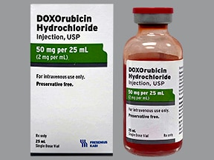
cardiotoxicity of common anticancer drugs
Anthracyclines
Known to cause dose dependent cardiotoxicity.
Mechanism of cardiotoxicity
1.Disrupts Normal catalytic site of Topoisomerase 2 Beta
DNA double strand breaks and increase in P53 and apoptosis of cardiomyocytes.

Slide 16
2.It disrupts the biogenesis of Electron transport chain proteins Defective Mitochondrial function.
3.Decreases antioxidant enzymes Freeradical Injury.

Slide 18
Anthracycline cardio toxicity-Manifestation
Acute
Early
Late
Acute Manifestations
Supraventricular Arrythmias
Transient LV dysfunction
ECG changes
In <1% of Patients and Reversible
Reflect Myocyte injury.
No proven strategies to predict the injury is progressive.
Elevation of Biomarkers may be clue to identify patients art risk

Slide 19
Early-with in one year of exposure
Late-After several years( median 7 years)
Common presentation is
Cardiomyopathy- Usually DCM
Heart failure

Slide 20
Risk factors for Anthracycline toxicity
1.Age
>65 years
Paediatric population(<18 years)
2.Cumulative Dose
3.Concomitant or Prior chest RT
4.Concomitant chemotherapy with
- Alkylating agent.
-Immuno or targeted therapy
5.Renal failure
6.Prior CVD

Slide 21
Dexrazoxane is an FDA approved Drug that is found to be effective in preventing Anthracycline cardiotoxicity.

Slide 22
Immunotherapy and Targeted therapy induced cardio toxicity.
1.ErbB2/HER2 neu Blocker
Trastuzumab
Pertuzumab
Anti tumour effect is by blocking HER2 cleavage ,resulting in Anti body dependent cell mediated cytotoxicity

Slide 23
Determinants of cardiotoxicity
1.Concomitant /prior use of Anthracycline
2.Chest Radiation
3. Older age
4.preexisting CVD
Mechanism of cardio toxicity
Structural and functional changes in contractile proteins and mitochondria,but rarely lead to cell death ? Potential reversibility(this has been recently challenged)

Slide 24
HERA trial
20- 30% of patients did not demonstrate LVEF recovery.
Molecular Mechanism of cardiotoxicity
the role of NRG/ErbB system.
NRG/ErbB system act as paracrine and juxtacrine system between cardiomyocytes and micro vascular endothelial cells.
NRG1 ErbB2 and ErbB4 PI3K/Akt
phosphorylation NOS

Slide 25
Pertuzumab with Trastuzumab
Used in metastaic HER2 positive ca.breast.
Phase III trial has not shown any significant cardiotoxicity .

Slide 26
2.Tyrosine Kinase and Monoclonal Antibodies induced cardiotoxicity
Tyrosine kinase (TK) is constitutively over expressed certain cancers and Leukaemias.
Which lead to proliferation of cancerous clonal cells or prevents their apoptosis.

Slide 27
VEGF signaling inhibitors
Used in-Renal cell ca
-GIST
-HCC
-Colon cancer
Bevacizumab- Humanised recombinant Anti VEGF MAB.
Adverse Events- 1.Systemic HTN
2.Heart failure
3.Arterial Thromboembolic events

Slide 28
Small molecule/Multiple TKIs
Sunitinib
Sorafenib
Axitinib
Pazopanib
Vandetanib
These inhibit multiple Tyrosine kinases,including VEGFR signaling

Slide 29
Sunitinib As Prototype.
Adverse effects As per large clinical trials
HTN - 5-47%
Decline in LVEF - 10%
LVEF decline is reversible and well responds to HF therapies

Slide 30
BCR-ABL targeted therapy.
Imatinib
Ist gen.TKI
Very low incidence of HF.
Dasatinib
Significant Pulmonary hypertension
Often reversible with cessation of drug
FDA recommendation.

Slide 31
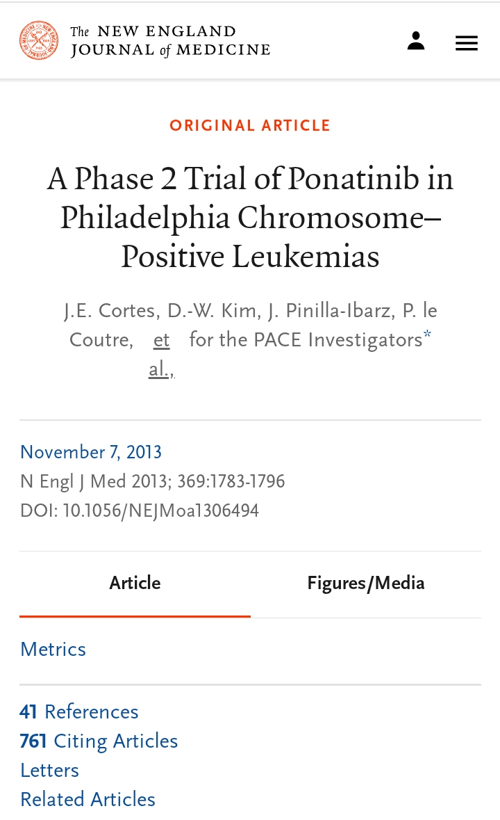
Nilotinib
POVD(1.3%-6.2%)
Ischemic heart disase
cardiometabolic-Hyperglycaemia
Hyperlipidaemia
QT prolongation
Ponatinib(PACE trial)
POVD(4%)
Ischemic heart disease
Heart failure

Slide 32
Ibrutinib
Brutons TKI
A/E- HTN
Arrythmias- SVT,VT

Slide 33
Cancer Immuno therapy and cardiotoxicity
Immune checkpoint inhibitors.
CTLA-4
PD-1
PDL-1

Slide 34
Immune check point inhibitor induced Myocarditis
- Usually occurs early (35-65 days)
-Myositis is a common Association.
-Late onset Myocarditis is also reported.
Arrythmias,Pericarditis are also reported
-?As part of Myocarditis

Slide 35
Additional Cancer Therapies
Proteosome Inhibitors
Bortezomib
Carfilzomib
Adverse effects
1.Heart failure(4.1%)
2.Hypertension(12.2%)
3.Arrythmias(2.4%)
4.Ischemia(1.8%)
Most of the events were for Carfilzomib.

Slide 36
Predictors Cardio Toxicity
1.History of HF
2.Base line Diastolic dysfunction
3.Abnormal NT-proBNP @ base line
4.Dose of Carfilzomib.
Proposed Mechanism of Toxicity
Proteosome Inhibitors alter protein homeostasis,Decrease phosphorylation of AMP kinase alpha and down stream autophagy related poteins like Raptor.

Slide 37
Hormonal Therapy
Androgen Deprivation therapy
GnRH agonist –Leuprolide,Goserelin
GnRH antagonist-Degarelix
Antiandrogens-Flutamide,Bicalutamide
Adverse effects
1.Weight gain(visceral Adiposity)
2.Insulin resistance
3.Dyslipidaemia( LDL&TG )
4.CAD
5.Heart failure & SCD

Slide 38
SERM and Aromatase Inhibitors
Tamoxifene
-Favourable effect on Lipid Profile.
-Increased risk of Thrombo embolic events.
Letrozole/Anastrozole
Adverse effects are due to loss of favorable
action of Estrogen on Lipids,antioxidant,Nos
-HTN
-DLP
-CAD

Slide 39
Radiation therapy
Crucial for good cancer control and survival rates.
Can occur with Supradiaphragmal and in certain group of patients with infradiaphragmal RT.
Determinants of Cardiotoxicity
-Dose Delivered/Field of radiation
-Younger Age
-Concomitant chemotherapy(Anthracycline)
-Lack of thoracic shield.
-Co morbid CVD including CAD.

Slide 40
Manifestations
1. Coronary Artery Disease
-Atherosclerotic and Nonatheroscerotic mechanism including vasospasm.
-Often complicated by Plaque rupture/thrombosis.
-Ostial lesions are frequent.
-LAD during Left breast irradiation
-LM,LCX,RCA during RT for Hodgkins Disese.
-Thoracic dose >30Gy is considered to cause vascular disease

Slide 41
Mechanism of CAD
Radiation induced endothelial Injury(freeradical).
Proinflammatory state
Platelet aggregation, thrombosis.
Replacement of injured intima with myofibroblast.

Slide 42
Clinical presentation.
- Asymptomatic(cardiac Autonomic neuropthy).
-CCS
-Fatal/Non fatal AMI.
-Sudden cardiac death.

Slide 43
Management
*CABG Vs PTCA
Difficulties in CABG
Vascular conduits/grafts may be scarred and fibrotic from prior RT.
Hostile chest- Friable skin,fibrosed vessels,poor wound healing,and excess bleed.
Significant calcification of thoracic aorta –difficulty in Aortic clamping

Slide 44
2.Valvulopathy
Prevalence-
26% @ 10years
60% @ 20 years
Pathophysiology
Valves will under go fibrosis ,thickening with or with out calcification.
Left sided valves are more commonly affected

Slide 45
AR >>AS
Mitral and Tricuspid involvement can occur.
(D/D from RHD- MV tips and commissures are spared with Radiation.)
Aorto mitral continuity calcification

Slide 48
Management
-Aortic stenosis is the pathology that most often requires correction.
* TAVR Vs SAVR
TAVR
-Low mortality
-In patients with High risk surgery with high Society of Thoracic Surgeons score.
- More hospitalization for Heart failure.

Slide 49
SAVR
-If concomitant CABG,or other valve surgery.
The out comes of TAVR and SAVR are compared to normal controls are worse in patients with prior RT.

Slide 50
3.Cardiomyopathy
Etiology – Fibrosis of Myocardium.
-Hypertrophy secondary to valve disease.
-Restrictive CM
- Diastolic Dysfunction,HFpEF
Prevalence - >10%
Median time of onset – 3.6 years.

Slide 51
Pathophysiology
-Radiation vasculopathy(microvascular,macrovascular), demand supply mismatch→ Myocardial cell death.
-Inflammatory state→smooth muscle cells →Myofibroblasts.
-Myocrdial fibrosis.
* More of Restrictive Cardiomyopathy.
* RV is more affected due to its anterior location.

Slide 52
Management.
- Goal directed therapy for HF.
- Cardiac transplant for advanced HF.
4. Pericardial Disease
Manifestations
- Acute pericarditis
-Chronic constrictive pericarditis.
- Cardiac tamponade.

Slide 53
Management
1. Medical
2. Surgical
Pericardiectomy for CCP
worst postoperative out comes and survival for RT induced CCP.

Slide 54
5. Conduction Anomalies.
- Sinus node Dysfunction
- Av blocks
-BBB(RBBB Common),Fascicular blocks
- QT Prolongation,VT
- Inappropriate Chronotropic response
- Loss of HR variability.
- Persistent Tachycardia.

Slide 55
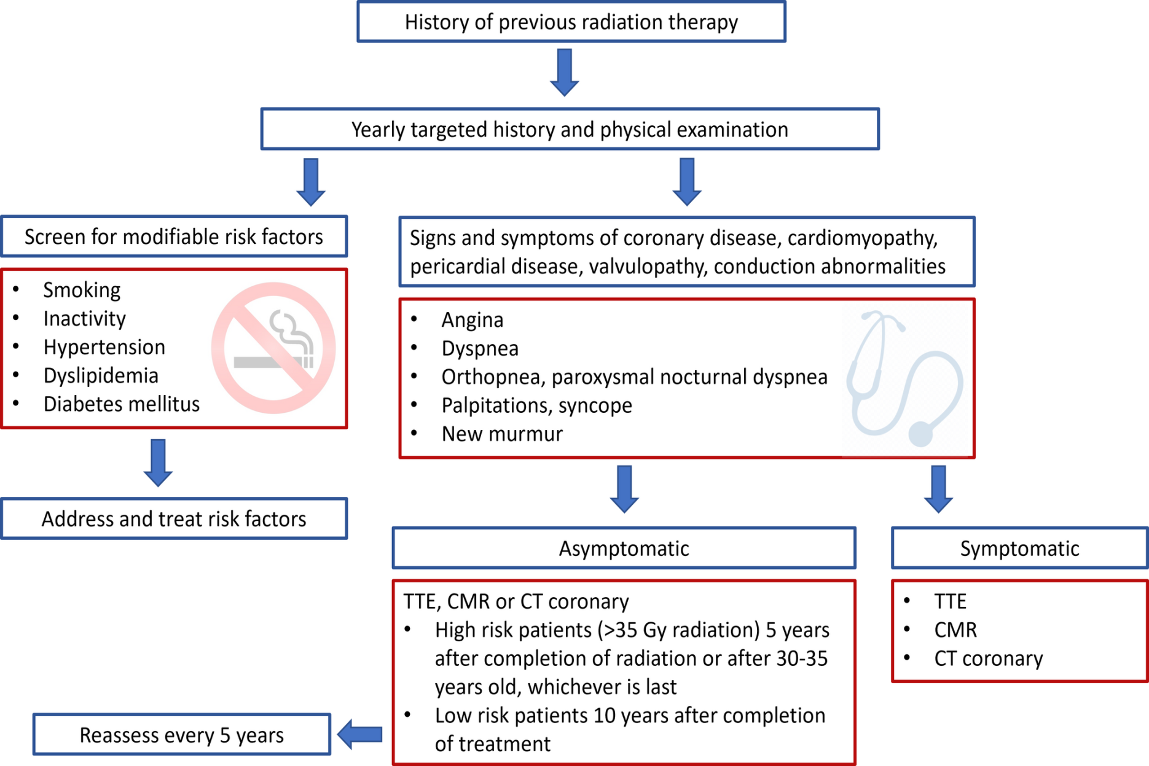
Screening and prevention.

Slide 56
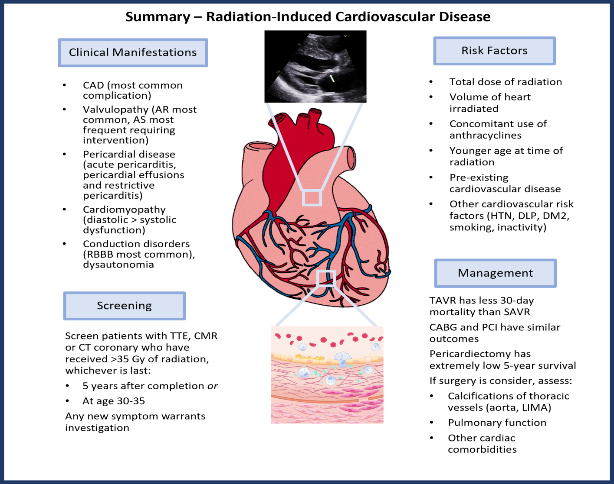

Slide 57
Cardio oncology- approach to the patient.
Diagnostic Tools to detect Myocardial Toxicity.
1.ECG
Arrythmias
QT prolongation
ST-T changes
Conduction anomalies
Ecg changes are not specific.
Cannot predict the development of CMP.

Slide 58
2. ECHO cardiography
Most commonly used method to detect myocardial dysfunction before,during and after chemotherapy.
All patients should undergo 2D,3D volume and LVEF measurements, GLS,RV size and systolic function.
Since Diastolic dysfunction occurs earlier than systolic,full Diastolic assessment to be done @baseline and follow up.

Slide 59
Systolic function Assessment
→Estimating LVEF is not supported.
→2D volumetric Simpson's is recommended, preferably from measurements in two planes (apical four- and two-chamber). Endocardial surface should be traced at end-diastole and end-systole, excluding papillary muscles and trabeculation.
→3D LVEF assessment allows for more precise contouring of the actual shape of the LV cavity and does not rely on the geometric assumptions as 2D LVEF assessment does. As such, 3D LVEF reportedly has superior reproducibility compared to 2D LVEF.

Slide 60
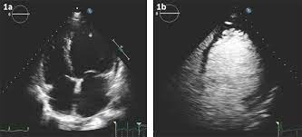
→When two contiguous LV segments from any apical view are not adequately seen, contrast is recommended, and should then be used in all sequential testing.(use contrast after recording GLS)

Slide 61
GLS through speckle-tracking ECHO cardiography
→Longitudinal strain is the degree of deformation from base to apex, with more negative values indicating greater deformation.
→GLS is obtained from all three standard apical views
→The two visible contours should outline the endocardial border and epicardial border with the region of interest aligned as accurately as possible to obtain the 17-segment LV model.

Slide 62
→ A normal GLS is typically defined as more negative than -17% for males and -18% for females.
→ A sequential change in GLS from -22% to -18% is considered significant, as it reflects a >15% change and is known to predict subsequent decline in LVEF.

Slide 63
RV function
Right heart assessment is being incorporated now as there is increasing evidences to suggests that RV abnormalities are of prognostic significance.

Slide 64
ECHO cardiographic defenition of Cardiotoxicity.
→Definite cardiotoxicity: a decline in 2D/3D LVEF by >10% (absolute percentage points) to a value <50%.
→Probable subclinical cardiotoxicity: a decline in 2D/3D LVEF by >10% to a value ≥50% with an accompanying decrease in GLS >15%.
→Possible subclinical cardiotoxicity: a decline in 2D/3D LVEF <10% to a value <50%.
or
LV GLS: A relative percentage reduction in GLS by >15% from baseline

Slide 65
If GLS is not concordant with LVEF, cardiac magnetic resonance imaging may be considered.
Frequency of monitoring varies according to different guidelines-so case –case based approach may be followed.
one in months during active phase of chemo/RT.
Post treatment surveilance can range B/W 1-5 years

Slide 66
3.Cardiac MRI
Accurate LV/RV Fn
Evaluation of pericardium
LGE in case of fibrosis- prognostic significance in case of low LVEF.
4.Nuclear cardiac Imaging
Previously used for years for CTRCD
Limitation- High radiation exposure

Slide 67
5.Cardiac Biomarkers
→Troponin I
→High Sensitivity Trop I
→BNP
→NT-Pro BNP
New elevation in Troponin during Anthracycline/Trastuzumab therapy can predict subsequent Lvdysfn.
There is no clear evidence to with hold chemotherapy based on abnormal biomarkers.
Role of BNP/NT proBNP in surveillance to define high risk patients is still not established.

Slide 68
Approach to cancer patient at risk or with cvd
1. Cardiomyopathy/Heart failure consideration.
*Earlier clasification as Type1,Type2
*current classification
-Direct harm full effect on myocardium.
-Indirect harm full effect on myocardium ie CAD,Metbolic derrangement.
-Mediated by Inflammation.

Slide 71
2.Vascular Disease Consideration.
a.Venous Thrombosis
Risk Factors

Slide 72
Risk Assessment

Slide 73
As per Guidelines from Various societies,DOACs are recommended as primary prophylaxis for VTE in ambulatory patients who are about to start cancer therapy and Khorana score >2.
In High risk patients LMWH can be used for out patient Thrombo Prophylaxis.
In Multiple myeloma patients on Immuno modulatory drugs
-Aspirin 81-325mg if only one individual risk factor.
-LMWH/WARFARIN if multiple risk factors.

Slide 74
Duration Of Anticoagulation
- Until the Patient is cured of cancer.
Treatment of VTE
Haemodynamically stable- LMWH/NOAC
Haemodynamically unstable patients
-No conclusive evidence of benefits for thrombolysis due to increased risk of bleeding(6 times).

Slide 75
b.Arterial thromboembolism(ATE)
Highest risk period is with in 1month before and after cancer diagnosis.
Therapy-related ATE is seen in patients On Anti VEGF and Platinum drugs.
c.Acute Vasospasm
-5 FU
-Capecitabine
-Paclitaxel
-Cisplatin
- Sorafenib

Slide 76
d.Accelerated Atherosclerosis
Radiotherapy
Nilotinib
Ponatinib
Cisplatin
VEGF inhibitors

Slide 77
Coronary artery Disease.

Slide 78
Management Of CAD
→Pre-existing CAD substantially increases the risk of developing treatment-related CAD.
→Challenges in management
Thrombocytopenia during chemotherapy.
→In patients treated by PCI who are subsequently found to have a malignancy, minimal duration of DAPT should be given as far as reasonable.

Slide 79
Valvular Heart Disease.
→ Chemotherapeutic agents do not directly affect cardiac valves.
→Mechanism of VHD
* pre-existing valve lesions
* Radiotherapy
*Infective endocarditis
*Secondary to LV dysfunction
→Diagnosis And management

Slide 80
Cardiac Arrythmia consideration
→QT prolongation
→Supraventricular arrythmias
→Ventricular arrythmias
→sinus node dysfunction and conduction defects

Slide 81
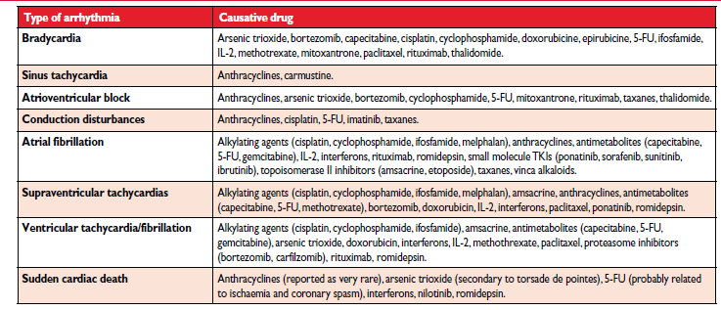

Slide 82
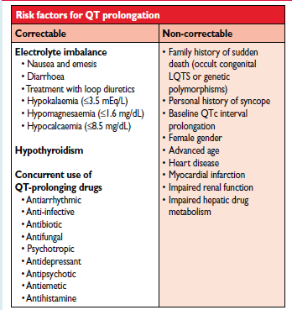
Conditions predisposing to QT prolongation in cancer patients.

Slide 84
Diagnosis and management
1.QT prolongation
Baseline ecg QTc ULN >450ms men
> 460ms women
→QTc prolongation >500 ms and a QT (i.e. change from baseline) of >60 ms→increased risk of Torsades depointes.
→Monitoring – 2Weekly following initiation
Monthly for next 3 months
For AS2O3 weekly monitoring

Slide 85
W/F diarrhoea.
Correct predisposing factors.
Drug checklist
Temporarly Holding chemotherapy if QTC>500 or >60ms.
Re start @ lower dose.
Bouts of Torsades managed with IV MgSo4

Slide 86
Atrial fibrillation/flutter.
Rate /Rhythm control
Anticoagulation
Role of CH2DS2 VASc score/HASBLED score.
Choice of anticoagulation

Slide 87
Systemic Hypertension
→VEGF inhibitors have a high risk (11–45%) of inducing new hypertension or destabilizing previously controlled hypertension.
→mechanism
Arterial rarefraction
Decrease NO
Renal TMA and Glomerular injury

Slide 88
Management
→ACE inhibitors or ARBs, beta-blockers and dihydropyridine calcium channel blockers are the preferred antihypertensive drugs.
Verapamil and diltiazem preferably avoided.
No releasing BB- Nebivolol
carvedilol

Slide 89
Pulmonary Hypertension
Drugs – Dasatinib.
- Stem cell Transplant.
- Cyclophosphamide
Dasatinib- Precappillary PH
Reversible on stopping the drug.
Cyclophosphamide- Pulmonary veno occlusive disease.
severe PH/Not reversible

Slide 91
POVD and stroke
Ponatinib and Nilotinib
Raynauds phenomenon- L- asparaginase
- Cisplatin
Stroke
Mediastinal/Cranial /Neck Irradiation
Mechanism-
1.Endothelial dysfn,thrombus formation.
2.Vasa vasorum occlusion and medial necrosis
3.Acelerated atheroslerosis.

Slide 92
Thank you

